Slide 1
Lecture 15 Wireless and Mobile Networks
A wireless network is made up of the following basic components:
Wireless host- which can be a laptop, PDA, phone or a desktop computer. The host may or may not be mobile
Wireless link – these are used to connect the host to a base station or to another wireless host
Base station – this is a key part of wireless network infrastructure. It is responsible for sending and receiving data to and from a wireless host that is associated with the base station
Cell towers in cellular networks and access points in 802.11 wireless LANs are examples of base stations.

Slide 2
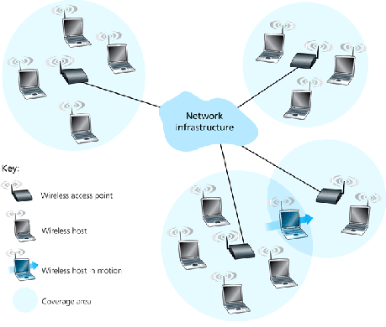
Elements of a wireless network

Slide 3
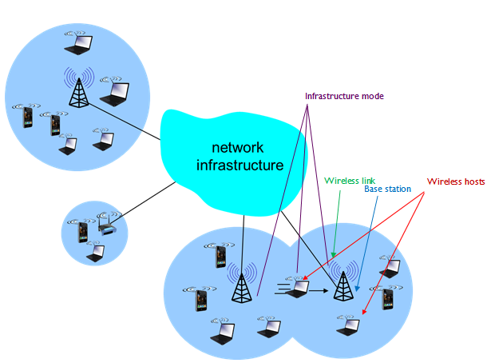
Elements of a wireless network

Slide 4
A base station has no obvious counter part in a wired network
A host and a wireless link can easily be related to counter parts in a wired network setup.
Note that cell towers used in cellular networks and access points used in IEEE 802.11 wireless LANs are examples of base stations.

Slide 5
Base station functions
A base station is connected to the larger network
It functions as a link-layer relay between the wireless host and the rest of the world with which host communicates.

Slide 6
Infrastructure operation mode
Hosts that are associated with a base station are often referred to as operating in infrastructure mode,
This is because all traditional network services such as address assignment and routing are provided by the network to which a host is connected via the base station.

Slide 7
Mobile ad hoc networks
These are also known as:
Wireless ad hoc networks
Ad hoc wireless networks
In ad hoc networks the hosts have no network infrastructure with which to connect.
The hosts themselves must provide for services such as routing, address assignment, name translation and other services provided by infrastructure based networks.

Slide 8
Handoff
When a mobile host moves beyond the range of one base station and into range of another,
it will change its point of attachment into the larger network and this process is referred to as handoff.

Slide 9
Mobile ad hoc network
Mobile ad hoc networks have shorter transmitting ranges.
The mobile ad hoc networks must not be confused with cellular wireless networks since cellular networks are infrastructure based. Diagram below shows an example of a cellular network.
Note that for cellular networks to operate there must be infrastructure based base stations and there should be also a public switched telephone network

Slide 10
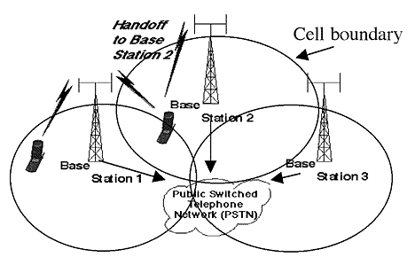
Mobile ad hoc network
The Mobile ad hoc networks need just one transmission source.

Slide 11
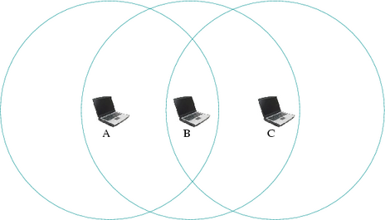
The Hidden and exposed stations problems in wireless communication

Slide 12
Hidden station problem
Consider three stations A, B and C. As can be seen from diagram, station A is within range of station B and so can communicate with B. B is within range of C and so can communicate with C. A is out of range with C and so cannot communicate with C. The hidden station problem arises when A communicates with B whilst C is communicating with B.

Slide 13
CSMA/CA
Using the carrier sense multiple access with collision avoidance (CSMA/CA). A will sense channel B and finds is free and will send data. C also wants to send data to B. C will sense B to be free and also sends data to B.
Both signals from A and C will reach B there will be collision.

Slide 14
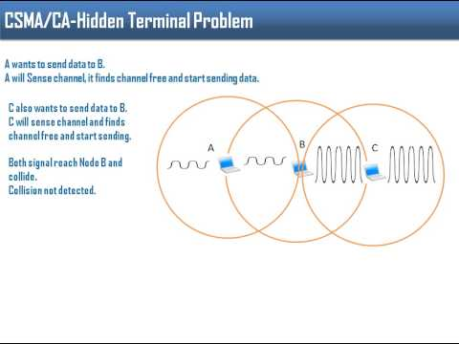
Data collision in a hidden station

Slide 15
Exposed station problem
Consider the previous diagram
A wants to send data to B but cannot send fearing that it will be interfering with C sending data to B. But C is not sending data to B. This is called the exposed station problem. C is exposed to A.

Slide 16
Exposed station

Slide 17
Multiple Access with Collision Avoidance (MACA)
MACA is a protocol for slotted media access control used in wireless LAN data transmission.
MACA is used to avoid data collisions caused by hidden station problems as well as simplifying known station problems.

Slide 18
MACA operation
In MACA, a wireless network node announces that it is going to send the data frame, informing the other nodes to remain silent.
When a node intends to transmit the data frame, it communicates using a signal known as Request-To-Send (RTS) that includes the length of the data frame to transmit.
If the recipient permits the transmission, it responds back to the sender with a signal known as Clear-To-Send (CTS), which includes the length of the data frame that it is about to receive.

Slide 19
MACA operation
In the meantime, the nodes that listen to the RTS signal must remain silent until the data is fully transmitted in order to avoid conflict with CTS.
Collisions among RTS packets may still occur in MACA, but they are minimized using a randomized exponential back-off strategy, much like the one that is used in regular Carrier Sense Multiple Access (CSMA).

Slide 20
MACA operation
Although collisions can occur between RTS packets, MACA still has an edge over CSMA, provided that the RTS packets are substantially smaller compared to the data packets.
If the RTS packets are significantly smaller, the collisions between RTS packets create less impact.

Slide 21
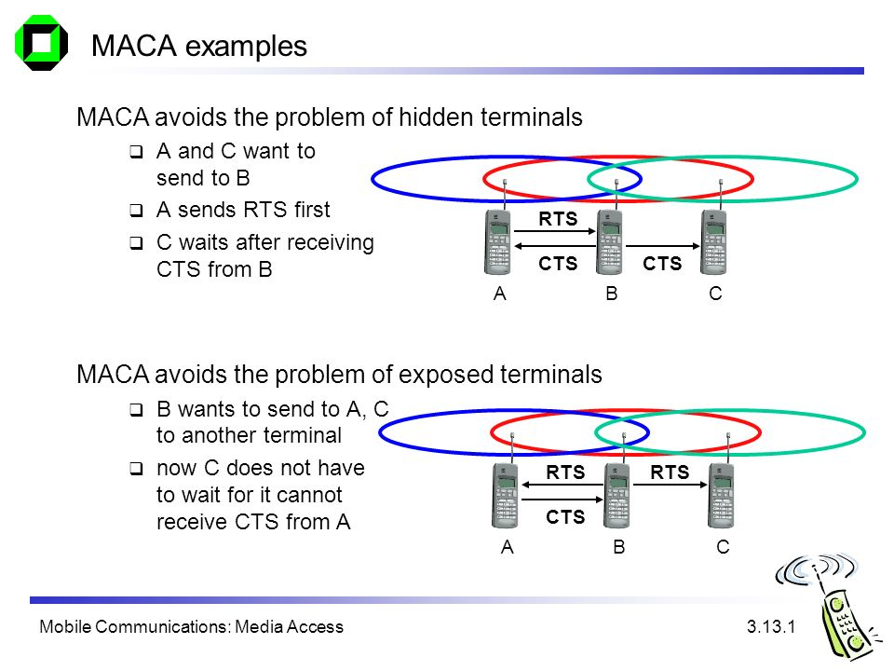
Solving the hidden problem with MACA

Slide 22
(MACA for wireless) MACAW
WLAN data transmission collisions can still happen, and MACA for Wireless (MACAW) is brought to extend the functionality of MACA. It demands nodes to send acknowledgments after every successful frame transmission. MACAW is commonly used in ad hoc networks. Moreover, it is the basis of various other MAC protocols found in wireless sensor networks (WSN

Slide 23
Solving the exposed problem with MACA

